Slide 1
Multidisciplinary Projects
Class 4a: Design

Slide 2
Agenda
System architecture
Three popular architectural styles

Slide 3
Learning Objectives
Understanding the system architecture
Three architecture styles

Slide 4
Design
The requirements describe the function of a system as seen by the client.
For a given set of requirements, the software development team must design a system that will meet those requirements.
In practice requirements and design are interrelated. In particular, working on the design often clarifies the requirements. This feedback is a strength of the iterative and agile methods of software development.

Slide 5
Design (cont.)
We have already looked at user interface design.
The next few lectures look at the following aspects of design:
system architecture
program design
security
performance

Slide 6
Creativity and Design
Software development is a craft.
Software developers have a variety of tools that can be applied in different situations.
Part of the art of software development is to select the appropriate tool for a given implementation.

Slide 7
Creativity and Design (cont.)
System and program design are a particularly creative part of software development, as are user interfaces. You hope that people will describe your designs as “elegant”, “easy to implement, test, and maintain.”
Above all strive for simplicity. The aim is find simple ways to implement complex requirements.

Slide 8
Creativity and Design (cont.)
System architecture is the overall design of a system
Computers and networks (e.g., monolithic, distributed)
Interfaces and protocols (e.g., http, ODBC)
Databases (e.g., relational, distributed)
Security (e.g., smart card authentication)
Operations (e.g., backup, archiving, audit trails)
At this stage of the development process, you should also be selecting:
Software environments (e.g., languages, database systems, class frameworks)
Testing frameworks

Slide 9
Models for System Architecture
Our models for systems architecture are based on UML
For every system, there is a choice of models
Choose the models that best model the system and are clearest to everybody.
When developing a system, every diagram must have supporting specification.
The diagrams shows the relationships among parts of the system, but much, much more detail is needed to specify a system explicitly.

Slide 10
Subsystems
A subsystem is a grouping of elements that form part of a system.
Coupling is a measure of the dependencies between two subsystems. If two systems are strongly coupled, it is hard to modify one without modifying the other.
Cohesion is a measure of dependencies within a subsystem. If a subsystem contains many closely related functions its cohesion is high.
An ideal division of a complex system into subsystems has low coupling between subsystems and high cohesion within subsystems.

Slide 11
Component
A component is a replaceable part of a system that conforms to and provides the realization of a set of interfaces.
A component can be thought of as an implementation of a subsystem.
UML definition of a component: “a distributable piece of implementation of a system, including software code (source, binary, or executable), but also including business documents, etc., in a human system.”

Slide 12
Components as Replaceable Elements
Components allow systems to be assembled from binary replaceable elements
A component is bits not concepts
A component can be replaced by any other component(s) that conforms to the interfaces
A component is part of a system
A component provides the realization of a set of interfaces

Slide 13
Components and Classes
Classes represent logical abstractions. They have attributes (data) and operations (methods).
Components have operations that are reachable only through interfaces.

Slide 14
Package
A package is a general-purpose mechanism for organizing elements into groups.

Slide 15
Node
A node is a physical element that exists at run time and provides a computational resource, e.g., a computer, a smartphone, a router.
Components may live on nodes.

Slide 16
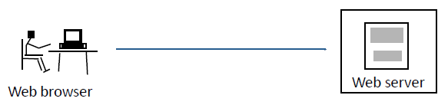
Example: Simple Web System
Static pages from serve
All interaction requires communication with server

Slide 17
Deployment Diagram

Slide 18
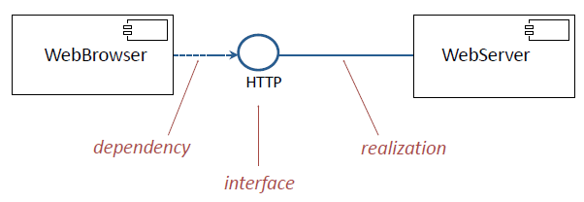
Component Diagram: Interfaces

Slide 19
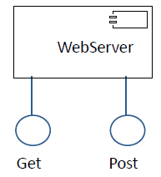
Application Programming Interface (API)
An API is an interface that is realized by one or more components.

Slide 20

Architectural Style: Pipe
Example: A three-pass compiler
Output from one subsystem is the input to the next.

Slide 21
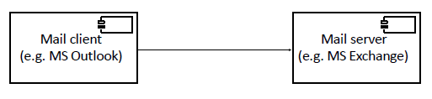
Architectural Style: Client/Server
Example: A mail system
The control flows in the client and the server are independent.
Communication between client and server follows a protocol.
In a peer-to-peer architecture, the same component acts as both a client and a server.

Slide 22
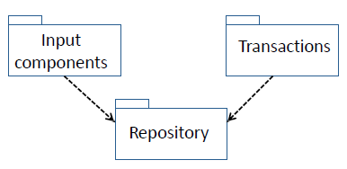
Architectural Style: Repository
Advantages: Flexible architecture for data-intensive systems.
Disadvantages: Difficult to modify repository since all other components are coupled to it.

Slide 23
Architectural Style: Repository with Storage Access Layer
Advantages: Data Store subsystem can be changed without modifying any component except the Storage Access.

Slide 24
Time-Critical Systems
A time-critical (real time) system is a software system whose correct functioning depends upon the results produced and the time at which they are produced.
A hard real time system fails if the results are not produced within required time constraints e.g., a fly-by-wire control system for an airplane must respond within specified time limits
A soft real time system is degraded if the results are not produced within required time constraints e.g., a network router is permitted to time out or lose a packet

Slide 25
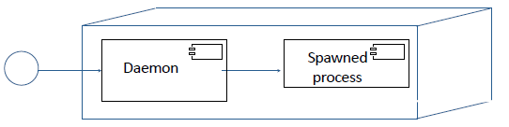
Time Critical System: Architectural Style - Daemon
A daemon is used when messages might arrive at closer intervals than the time to process them
Example: Web server
The daemon listens at port 80
When a message arrives it: spawns a processes to handle the message returns to listening at port 80

Slide 26
Architectural Styles for Distributed Data
Replication: Several copies of the data are held in different locations.
Mirror: Complete data set is replicated
Cache: Dynamic set of data is replicated (e.g., most recently used)
With replicated data, the biggest problems are concurrency and consistency

Slide 27
Batch Processing with Master File Update
Electricity utility customer billing (e.g., NYSEG)
Telephone call recording and billing (e.g., Verizon)
Car rental reservations (e.g., Hertz)
Bank (e.g., Tompkins Trust)
University grade registration (e.g., IU)

Slide 28
Batch Processing with Master File Update
Example: Electricity Utility Billing
Requirements analysis identifies several transaction types:
Create account/ close account
Meter reading
Payment received
Other credits/ debits
Check cleared/ check bounced
Account query
Correction of error
etc., etc., etc.,

Slide 29
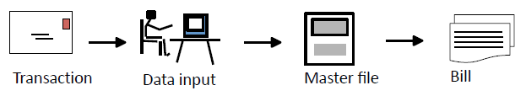
First Attempt
Each transaction is handled as it arrives.

Slide 30
Criticisms of First Attempt
Where is this first attempt weak?
All activities are triggered by a transaction.
A bill is sent out for each transaction, even if there are several per day.
Bills are not sent out on a monthly cycle.
Awkward to answer customer queries.
No process for error checking and correction.
Inefficient in staff time.

Slide 31
Batch Processing: Edit and Validation

Slide 32
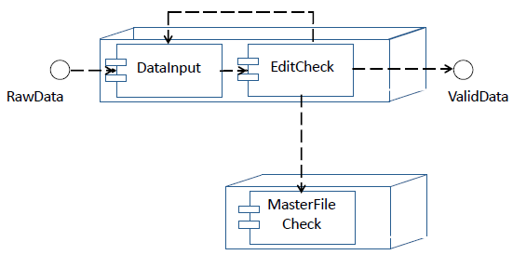
Deployment Diagram: Validation

Slide 33
Batch Processing: Master File Update-MFU

Slide 34
Benefits of Batch Processing with MFU
All transactions for an account are processed together at appropriate intervals, e.g., monthly.
Backup and recovery have fixed checkpoints.
Better management control of operations.
Efficient use of staff and hardware.
Error detection and correction is simplified.

Slide 35

Architectural Style: MFU (Basic Version)
Advantages:
Efficient way to process batches of transactions.
Disadvantages:
Information in master file is not updated immediately.
No good way to answer customer inquiries.

Slide 36
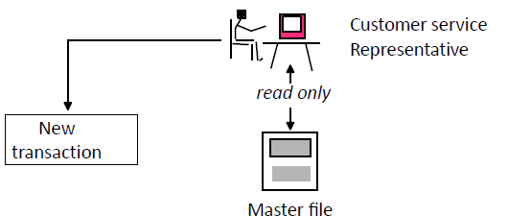
Online Inquiry
A customer calls the utility and speaks to a customer service representative.
Customer service department can read the master file, make annotations, and create transactions, but cannot change the master file.

Slide 37
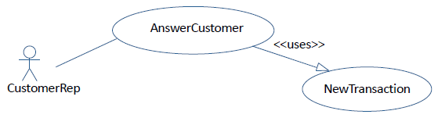
Online Inquiry: Use Case
The representative can read the master file, but not make changes to it.
If the representative wishes to change information in the master file, a new transaction is created as input to the master file update system.

Slide 38
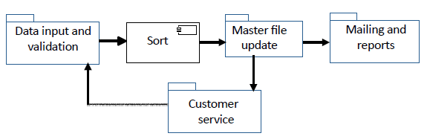
Architectural Style: Master File Update (Full)
Advantage:
Efficient way to answer customer inquiries.
Disadvantage:
Information in master file is not updated immediately.

Slide 39
Example 2: Three Tier Architecture-TTA
The basic client/server architecture of the web has:
a server that delivers static pages in HTML format
a client (known as a browser) that renders HTML pages
Both client and server implement the HTTP interface.
Extend the architecture of the server so that it can configure HTML pages dynamically.

Slide 40
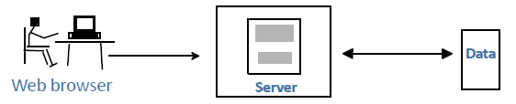
Web Server with Data Store
Advantage:
Server-side code can configure pages, access data, validate information, etc.
Disadvantage:
All interaction requires communication with server

Slide 41
Architectural Style: TTA
Each of the tiers can be replaced by other components that implement the same interfaces.

Slide 42
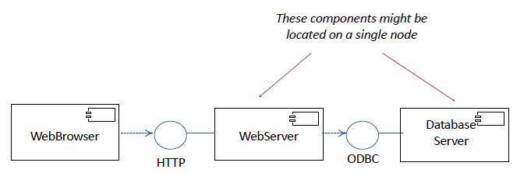
Component Diagram

Slide 43
TTA: Broadcast Searching
This is an example of a multicast protocol.
The primary difficulty is to avoid troubles at one site degrading the entire system (e.g., every transaction cannot wait for a system to time out).

Slide 44
Extending the Architecture of the Web
Using a three tier architecture, the web has:
a server that delivers dynamic pages in HTML format
a client (known as a browser) that renders HTML pages
Both server and client implement the HTTP interface.
Every interaction with the user requires communication between the client and the server.
Problem 2 Extend the architecture so that simple user interactions do not need messages to be passed between the client and the server.

Slide 45
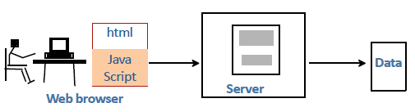
Extending the Web with Executable Code that can be Downloaded
Executable code in a scripting language such as JavaScript can be downloaded from the server
Advantage:
Scripts can interact with user and process information locally.
Disadvantage:
All interactions are constrained by web protocol

Slide 46
Extending the Three Tier Architecture
In the three tier architecture, a web site has:
a client that renders HTML pages and executes scripts
a server that delivers dynamic pages in HTML format
a data store
The three tier architecture with downloadable scripts is one the ways in which the basic architecture has been extended. There are some more:
Protocols: e.g., HTTPS, FTP, proxies
Data types: e.g., helper applications, plug-ins
Executable code: e.g., applets, servlets
Style sheets: e.g., CSS

Slide 47
Example 3: Model/View/Controller (MVC)
The definition of Model/View/Controller (MVC) is in a state of flux. The term is used to describe a range of architectures and designs.
Some are system architectures, where the model, view, and controller are separate components.
Some are program designs, with classes called model, view, and controller.
We will look at three variants:
An MVC system architecture used in robotics.
A general purpose MVC system architecture used for interactive systems.
Apple’s version of MVC as a program design for mobile apps.

Slide 48
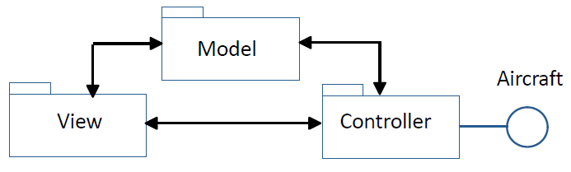
Model/View/Controller in Robotics
Controller: Receives instrument readings from the aircraft, updates the view, and sends controls signals to the aircraft.
Model: Translates data received from and sent to the aircraft, and instructions from the user into a model of flight performance. Uses domain knowledge about the aircraft and flight.
View: Displays information about the aircraft to the user on the ground and transmits instructions to the model via the controller.

Slide 49
Example 3: MVC for Mobile Apps

Slide 50
Model
The model records the state of the application and notifies subscribers. It does not depend on the controller or the view.
stores the state of the application in suitable data structures or databases
responds to instructions to change the state information
notifies subscribers of events that change the state
may be responsible for validation of information

Slide 51
View
The view is the part of the user interface that presents the state of the interface to the user. It subscribes to the model, which notifies it of events that change the state.
renders data from the model for the user interface
provides editors for properties, such as text fields, etc.
receives updates from the model
sends user input to the controller
A given model may support a choice of alternative views.

Slide 52
Controller
The controller is the part of the user interface that manages user input and navigation within the application.
defines the application behavior
maps user actions to changes in the state of the model
interacts with external services via APIs
may be responsible for validation of information
Different frameworks handle controllers in different ways. In particular there are several ways to divide responsibilities between the model and the controller, e.g., data validation, external APIs.

Slide 53
External Services for Mobile Apps
Mobile apps often make extensive use of cloud-based external services, each with an API (e.g., location, validation). These are usually managed by the controller.

Slide 54
Apple’s Version of MVC
The diagram shows the model, view, and controller as components. In practice the Model-View-Controller is a program design with three major classes.

Slide 55
An Exam Question
A company that makes sports equipment decides to create a system for selling sports equipment online. The company already has a product database with description, marketing information, and prices of the equipment that it manufactures.
To sell equipment online the company will need to create: a customer database, and an ordering system for online customers.
The plan is to develop the system in two phases. During Phase 1, simple versions of the customer database and ordering system will be brought into production. In Phase 2, major enhancements will be made to these components.

Slide 56
An Exam Question (cont.)
a) For the system architecture of Phase 1:
i). Draw a UML deployment diagram.

Slide 57
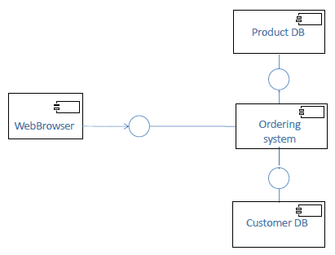
An Exam Question (cont.)
a) For the system architecture of Phase 1:
i). Draw a UML deployment diagram.

Slide 58
An Exam Question (cont.)
(b) For Phase 1:
i). What architectural style would you use for the customer database? Repository with Storage Access Layer
ii). Why would you choose this style? It allows the database to be replaced without changing the applications that use the database.

Slide 59
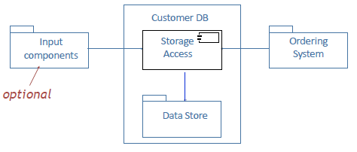
An Exam Question (cont.)
(b) For Phase 1:
iii). Draw an UML diagram for this architectural style showing its use in this application.

